Slide 1
INTRODUCTION TO HTML
HyperText Markup Language

Slide 2
HTML is not considered a programming language but simply a markup language.
  A markup language is a text-encoding system which specifies the structure and formatting of a document and the relationship between its parts.
  HTML is the standard markup language for Web pages.
HTML is a markup language because it allows users to organise the appearance and presentation of all the content that should go on a web page and uses tags to define elements within a document.

Slide 3
HTML Editors
We can use several editors for HTML such as; Sublime, Notepad++, TextEdit, Visual Studio Code etc. However for the purpose of this lecture we will be using just
Sublime:
https://www.sublimetext.com/download
VS Code:
https://code.visualstudio.com

Slide 4
INTRODUCTION TO HTML - TAGS
HTML is used in creating documents for the web browser, it makes use of tags
The different HTML tags are used to tell your browser how to display the web pages you visit
Tags are the building blocks of HTML documents.
Tags could be Non-self Closing Tags or self-closing Tags. General Syntax is as shown below:
  Non-self Closing: <tagname> contents </tagname>
  Self Closing : <tagname /> OR < tagname>

Slide 5
Types of HTML Element
An element is a tags plus content

Slide 6
What is an HTML Element?
An HTML element is defined by a opening tag, some content, and a closing tag:
          <> … </>
<tagname> Content goes here... </tagname>
The HTML element is everything from the start tag to the end tag:
      <h1>My First Heading</h1>
      <p>My first paragraph.</p>
Some HTML elements will display correctly, even if you forget the closing tag. However, never rely on this! Unexpected results and errors may occur if you forget the end tag!
HTML can be Semantic and Non-semantic.

Slide 7
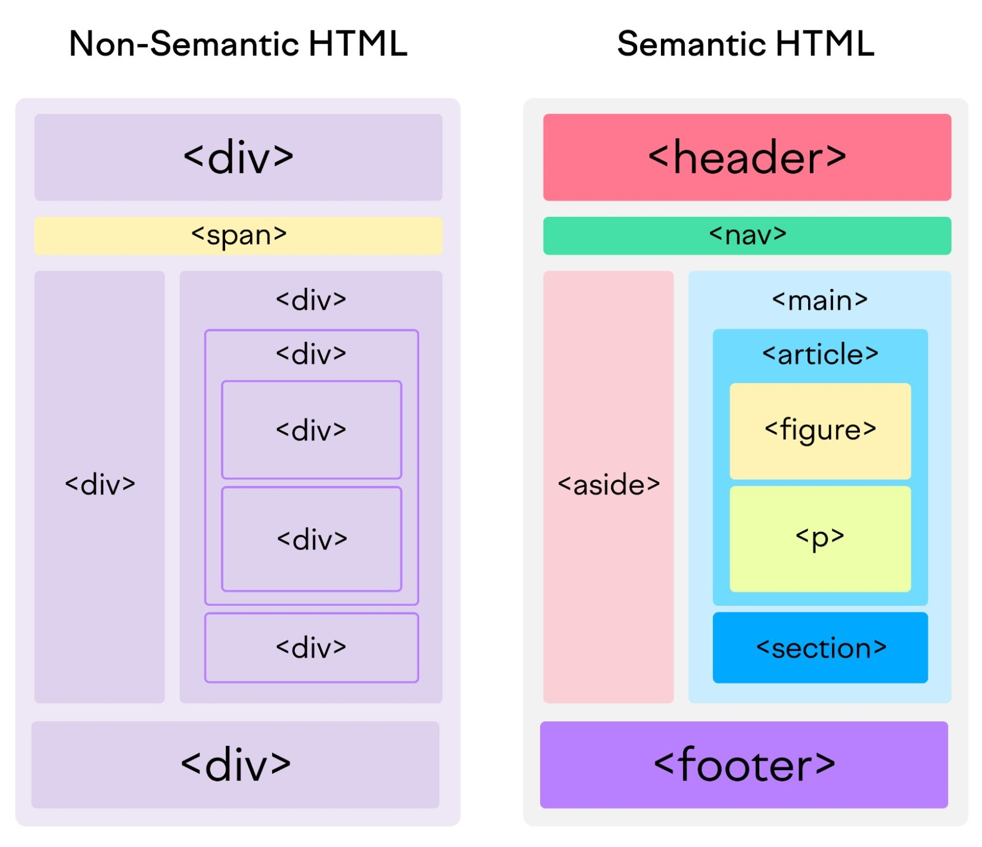
Semantic HTML refers to the use of HTML tags that convey the meaning—or semantics—of the content contained within them.
By adding semantic HTML tags to your pages, you provide additional information that helps define the roles and relative importance of the different parts of your page.
(As opposed to non-semantic HTML, which uses tags that don’t directly convey meaning.)

Slide 8
Understanding the Anatomy of an HTML Document
All web pages no matter how simple or complex have a structure similar to:
<!DOCTYPE html>
<html>
  <head>
  <title>
  My New Webpage
  </title>
  </head>
  <body>
  </body>
</html>
Take note of the HEAD and BODY – don’t human beings have HEAD and BODY too?
The <head> tag contains other tags that give information to the browser about the document.
Notable in the head section are: the <title> tag and various <meta> tags

Slide 9
THE <!DOCTYPE> DECLARATION
The <!DOCTYPE> declaration represents the document type, and helps browsers to display web pages correctly.
It must only appear once, at the top of the page (before any HTML tags).
The <!DOCTYPE> declaration is not case sensitive.
The <!DOCTYPE> declaration for HTML5 is:
<!DOCTYPE html>

Slide 10
Common Components of web pages
The following are components usually found on web pages:
  Texts
  Links
  Images / icons
  Multimedia (audio, video)
  Data Capture Forms
In HTML module, we will be learning the tags for placing these components
QUIZ: Think of any website /web application and try to see the components… anything outside the list?

Slide 11
Html tags for placing texts
Paragraphs
Heading
Span
And more…
PLACING TEXTS ON YOUR WEBPAGE
The Paragraph tags <p></p>
The Heading tags (h1 to h6)
The span tags <span></span>
A paragraph always starts on a new line, and browsers automatically add some white space (a margin) before and after a paragraph.

Slide 12
Other common tags
The break <br> tag. This can be used if you want a line break without starting a new paragraph:
The horizontal rule <hr>. The <hr> element is used to separate content (or define a change) in an HTML page:
The Poem Problem Example
The preformatted text <pre></pre>. The text inside a <pre> element is displayed in a fixed-width font (usually Courier), and it preserves both spaces and line breaks:
The Abbreviation tag <abbr>, defines an abbreviation or an acronym using the title attribute. <abbr title=“As Known As”>AKA</abbr>
HTML comment: This is not displayed in the web browser; may serve as documentation in your source code. To comment in HTML, you use;
<!-- content to comment -->

Slide 13
THE HEADING TAGS
The Heading tags: (h1 to h6)
<h1></h1> to <h6></h6>
  Search engines use the headings to index the structure and content of your web pages.
  Users skim your pages by its headings. It is important to use headings to show the document structure.
  QUIZ: Try out any 3 heading tags, what do you observe as the number increases?

Slide 14
INLINE AND BLOCK LEVEL ELEMENTS
By default, HTML displays its elements in one of the following ways:
Inline: These elements do not force new lines before or after its placement, and it only consumes as much space as necessary.
Block: A block-level element always starts on a new line, and the browsers automatically add some space (a margin) before and after the element. New lines appear before and after the element with it consuming the full width available.

Slide 15
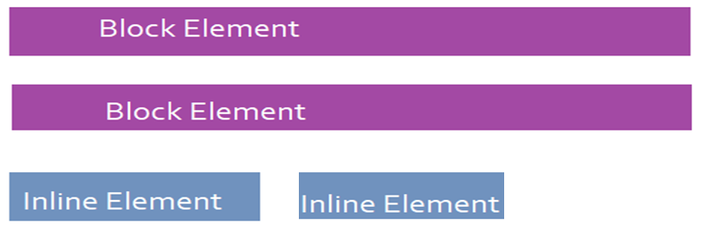
HOW THE WEB BROWSER DISPLAY CONTENTS

Slide 16
Some common Block and Inline Elements
Block-level Element
<h1>-<h6>
<ul> and <ol> and <li>
<div>
<table>
<p>
<form>
<nav>
<hr>
Etc…
Inline Elements
<a>
<b> and <strong>
<br>
<input>
<small>
<button>
<i>
<span>
<img>
Etc…

Slide 17
Exercise: Block level and inline elements
Below is a section of a company’s website where the testimonials of customers are displayed, two happy customers have sent in their testimonials.
Achieve the below using an appropriate tag combination:
Testimonials
1. “I love your service!” – Jane
2. “I will always recommend you guys” - Ayo

Slide 18
Bold & Strong and Italic & Emphasis
HTML bold tag is represented by <b> tag. It is used to display the written text in bold format. It is a paired tag. If you want to show your text in bold letters, then put it within <b> . . . </b> tag.
The <strong> tag adds extra semantic meaning and importance to the HTML document. It is recommended to use strong tag for bold format now.
The italic Tag is like putting something in italics just for looks, <i></i>
while <em> Tag is for adding real emphasis or importance to the text, indicating that it should be read with more attention. It also looks italicized but <em> have a meaning beyond appearance

Slide 19
HTML TEXT FORMATING
Just like the bold/strong and the italic/emphasis tags, there are other formatting tags for our HTML text.
The HTML <u> Tag defines Underlined text. All the text within the <u> and </u> tags will be underlined.
The HTML <small> Tag defines small text. This text is used for some side commenting or to write some copyright information.
The HTML <del> element defines Deleted text. This displays Text with a line strike.
The HTML <sub> element defines subscripted text. This type of text is small in size and is placed slightly below the normal line of text. While the <sup> place the text slightly above. The sub and sup tags. <sub></sub> and <sup></sup>. Example, H2O.
H<sub>2</sub>O and H<sup>2</sup>O

Slide 20
Exercise:
Achieve the following using the appropriate HTML tags.
I am learning Programming and currently on HTML
The weather outside is about 2°C degrees Celsius.
I have completed this task and now relaxing outside
I am currently learning HTML and its fun.
The equation is: L₄ + H² + K₃²

Slide 21
The LIST Element: Ordered and Unordered
THE ORDERED LIST:
This list is created by using <ol> tag. Any series can be used to order the elements, like series of digits, alphabets, roman numerals, etc. All these series gets increased by one with every new element entered in the list.
An ordered list starts with the <ol> tag. Each list item starts with the <li> tag.
The list items will be marked with numbers by default
<ol>
<li>Coffee</li>
<li>Tea</li>
<li>Milk</li>
</ol>
Coffee
Tea
Milk

Slide 22
The type Attribute for an Ordered List
NOTE: ordered list uses the type attribute to control the listing.
Type Description
type="1" The list items will be numbered with numbers (default)
type="A“ The list items will be numbered with uppercase letters
type="a" The list items will be numbered with lowercase letters
type="I" The list items will be numbered with uppercase roman numbers
type="i" The list items will be numbered with lowercase roman numbers

Slide 23
Ordered List: The "Start" Attribute
The start attribute is used to control the counting in the list. By default, the counting starts from '1' or from 'a', but we can change counting to start from a specified number or alphabet. Look at the example below to see the syntax of using this attribute.
<ol start="50">
<li>Samsung</li>
<li> Iphone </li>
<li>Nokia</li>
</ol>
50. Samsung
51. Iphone
52. Nokia

Slide 24
Unordered List:
HTML unordered list is a collection of related items that are listed with no special order or sequence.
<ul>
<li> Harley-Davidson </li>
<li> Ducati </li>
<li> BMW </li>
</ul>
The Unordered list also uses the type attributes set to the parent <ul>, and they are;
type="disc" Sets the list item marker to a bullet (default).
type="circle" Sets the list item marker to a circle.
type="square" Sets the list item marker to a square.
type="none" The list type will remove the bullets.
Harley-Davidson
Ducati
BMW

Slide 25
Nested Tags: list inside another list
Tags can be placed within another tag…
<ul>
<li>Cars</li>
<li>House</li>
<li>Cities
<ol>
<li>Jos</li>
<li>Ikeja</li>
</ol>
</li>
<li>Fruits</li>
</ul>
Cars
House
Cities
1. Jos
2. Ikeja
Fruits
Note: The nested tag came before the closing </li>, and the new tag begin with an ol or ul.

Slide 26
Class Exercise.
Politics
Entertainment
  a. TV shows
  b. Music
  POPULAR MUSIC GENRE
  A. Rap
  B. Classical
  C. Pop
  c. Movies
Sport
  1. Basket ball
  2. Football
  i. Champions league
  ii. Premier league
  3. Boxing

Slide 27
Assignment 1:
Create a single personal web page using various tags you have learnt to style. Also use the various <h> tags to highlight different Headings such as ‘About Me’, ‘Hobbies’, Education’, ‘Experience’, etc…
NOTE: itemize your hobbies using of list tags.

